Slide 1
Discussion on Microfinance Econ 541
Pushpinder Puniha
PhD Program
SPPD, USC

Slide 2
Brief Recap
Credit paradox in development: Why does not capital flow from rich to poor countries?
Credit market characteristics in developing countries
Information asymmetries
High transaction costs
Lack of collateral securities
Adverse selection
Moral Hazard

Slide 3
Microfinance Solution
Affinity groups or Self-help groups
Self selection of members of the group
Joint liability of the group members
Peer monitoring among the group members
Social sanctions against loan defaulters

Slide 4
Timeline of Microfinance Paradigm
Pre 1970s: Mutual 2008-2010:
Saving Societies in 1990s: Theoretical Foundations Challenges to Positive
Poor Communities of Microfinance Established Impacts
1970s and 80s: Yunus’ social 2005: Nobel Peace Prize
experiments in Jobra, Bangladesh to Yunus and Grammen
and establishment of Grameen and Foundation
BancoSol

Slide 5
Paradigm of Microfinance
Evidence
Success of Grameen in Bangladesh & BancoSol in Bolivia
Decreases in Poverty in Bangladesh & Bolivia
Claim
Poor are credit worthy
Lack of affordable credit causes poverty
Warrant
Poor possess entrepreneurial skills
Access to credit bridges most, if not all, market failures

Slide 6
Discussion of Susma’s Story
Are the poor bankable?
Is poverty cause by lack of credit?
Do poor possess entrepreneurial skills?
Can access to credit bridge all market failures confronting the poor?
Is microfinance preferable to the basic needs, capabilities, or vicious circles of poverty approaches?

Slide 7
Debate on Impact of Microfinance
Muhammad Yunus (2007) “5% of the Grameen borrowers get out of poverty every year.”
Abhijit Banerjee et. al (2009) “At least in the short term (within 15-18 months), microfinance does not appear to be a recipe for changing education, health, or women’s decision making.”

Slide 8
Debate on Impact of Microfinance
Karlan and Zinman (2009) “ We find no evidence of improvements in measure of subjective well being (of those who received microloans).”
Karnani (2008), Bateman (2010) Despite the hoopla over microfinance, it does not cure poverty but stable jobs do. Microfinance takes investment away from small and medium industries that could provide stable jobs.

Slide 9
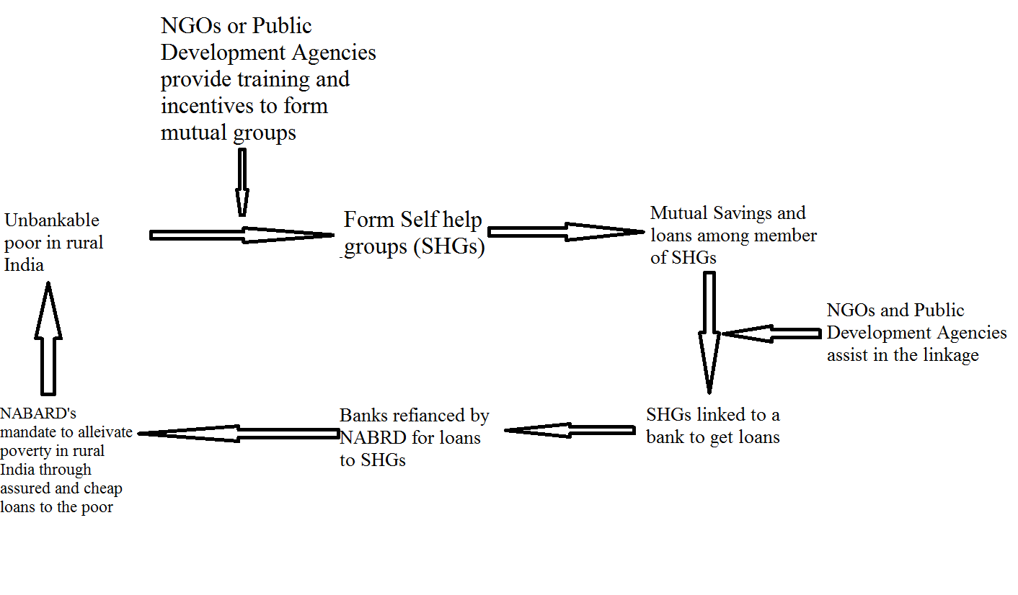
A Network View of a Microfinance Scheme in India

